Slide 1
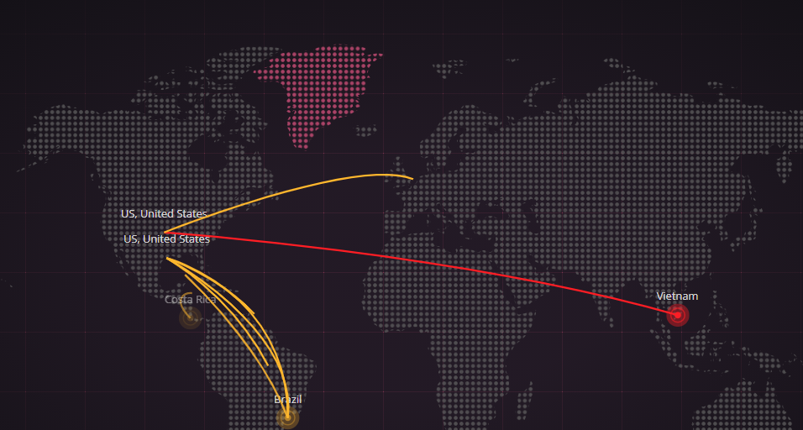
Cyber Threat Map
Can we predict the next Cyber Attack ?
Can we predict the next Cyber Attack Type?
Which Country is the Origin of Most Cyber Attacks by Period
Netanel Levi
MY_GITHUB
01/05/21

Slide 2
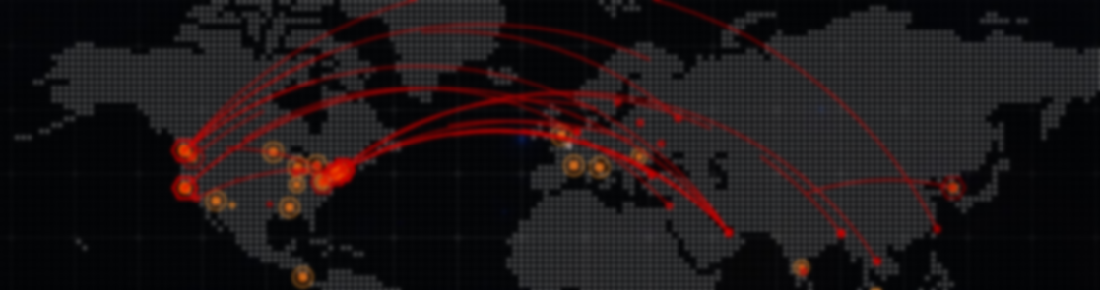
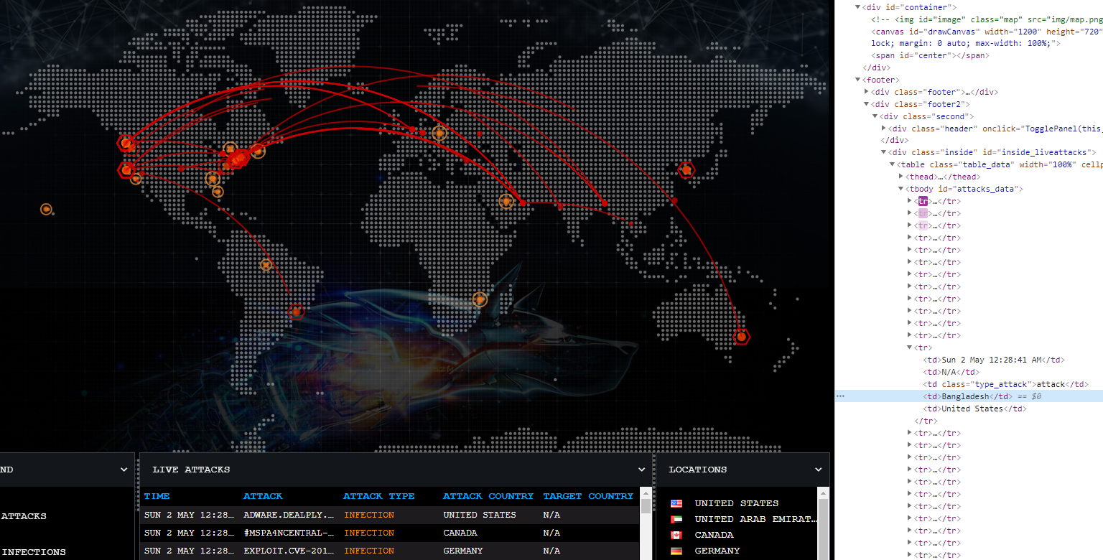
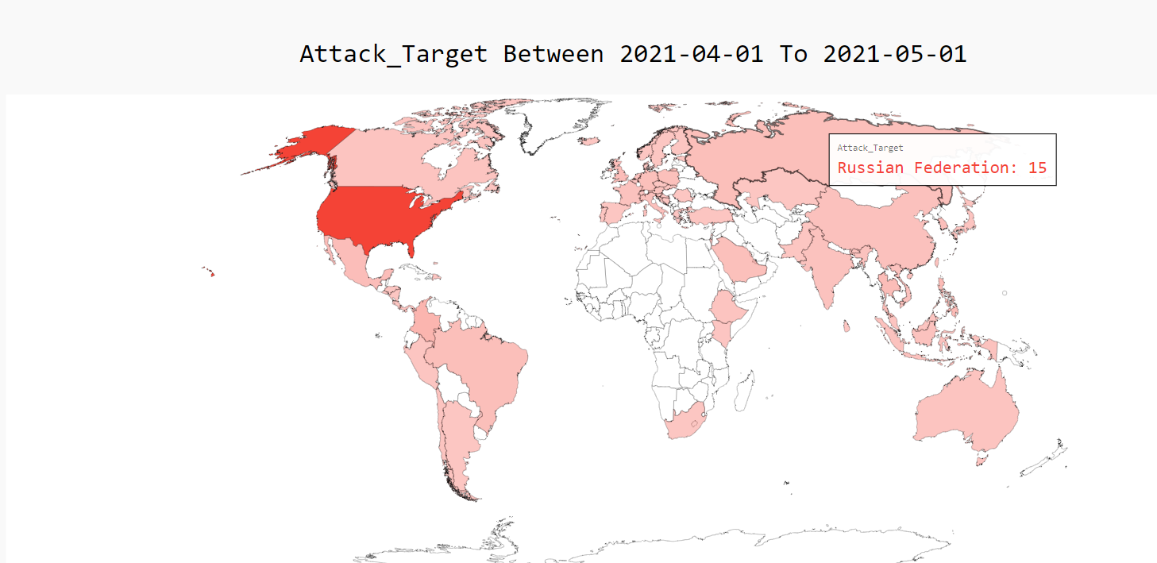
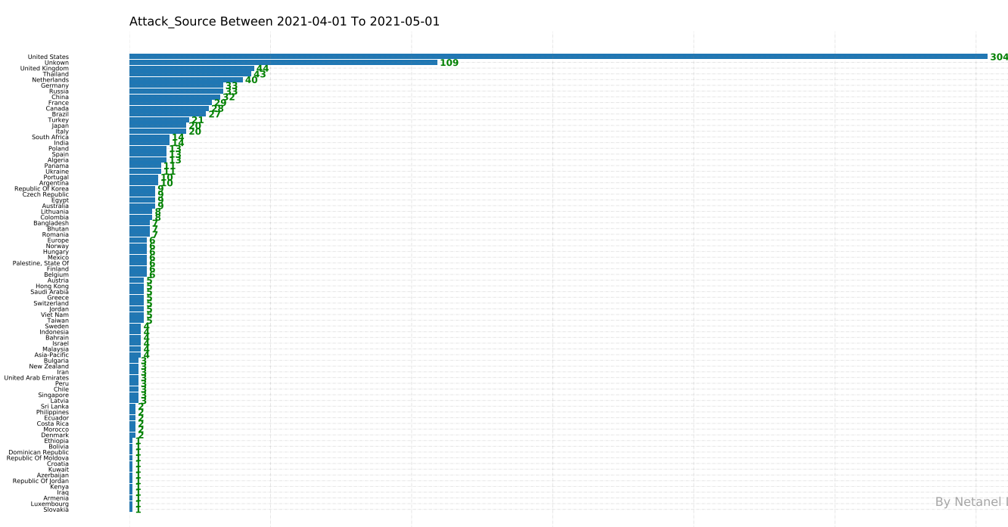


The Research Goal
Problem:
Everyday tens of millions of cyber attacks take place around the world.
Each attack split to different type: Injection, Malware, Spam DDOS, Exploit Vulnerability and more…
Each attack can make a lot of damage for Industry company , government services and more…
My Solution:
Predict from which country is the source of the next cyber attack
Predict which country is going to be attacked and what kind of cyber attack.
How I do it ?
1. Obtaining Data
Cleaning data Remove duplicates Word syntax amendment data Preparation data for EDA
RandomForestClassifier model
Predict the 5 Project goals
LabelEncoder to encode a pandas DataFrame
3. EDA
Web crawling to live threat
map website:
Threat map FortiGuard
Fire eye Cyber Map
Threat map Bitdefender
Threat Map Checkpoint
World Map Visualizations
Graph Visualizations
Collect and display data
2. Scrubbing Data
4. ML

Slide 3

Obtaining Data
Obtaining the data done by web crawling to four live threat website :
https://threatmap.checkpoint.com/
https://www.fireeye.com/cyber-map/threat-map.html
https://threatmap.bitdefender.com/
https://threatmap.fortiguard.com/
Each website display live attacks by the best company of cyber security defend

Slide 4
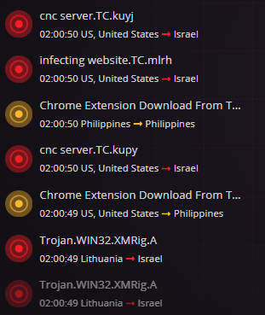
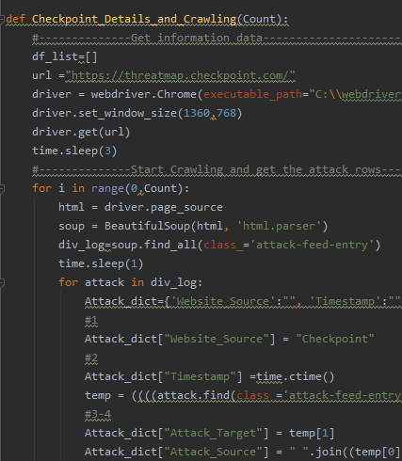
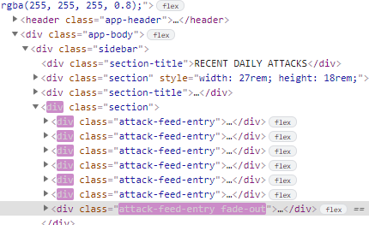
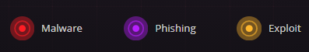
Obtaining Data
Checkpoint Web Crawling
By selenium I grab the attacks at real time , with BeautifulSoup I using Parsing and export
the relevant data :
Timestamp
Attack Source
Attack Target
Attack Type
Attack Name

Slide 5
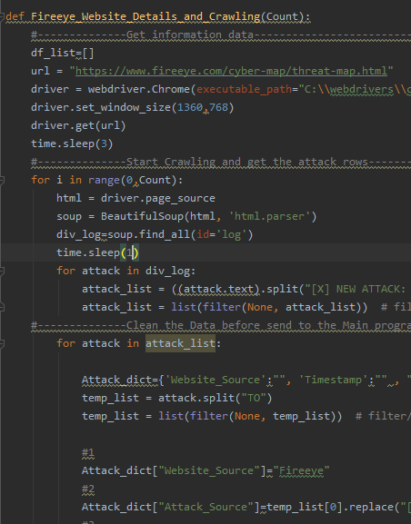
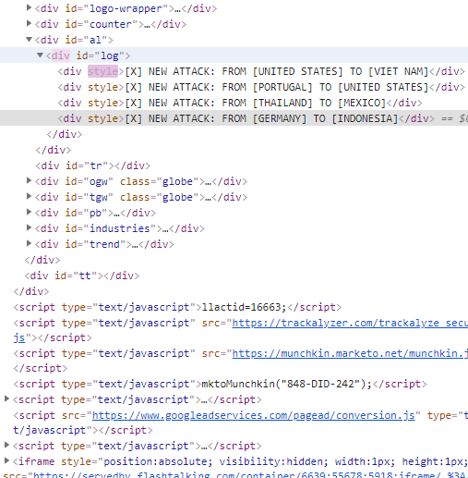
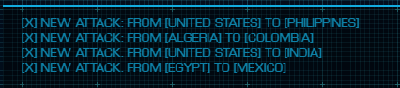
Obtaining Data
Fire eye Web Crawling
By selenium I grab the attacks at real time , with BeautifulSoup I using Parsing and export
the relevant data :
Timestamp
Attack Source
Attack Target

Slide 6
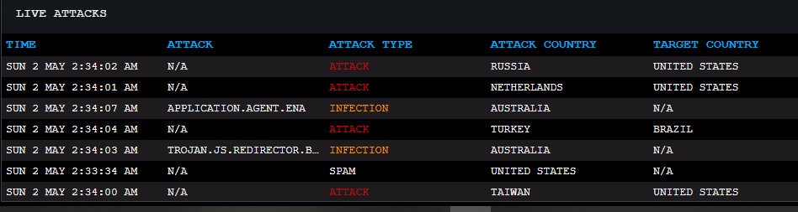
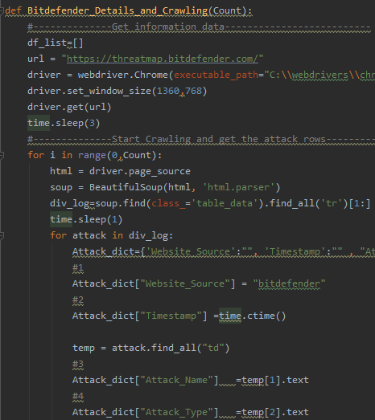
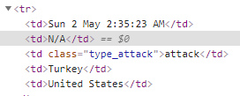
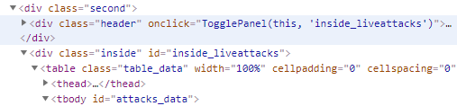
Obtaining Data
Bitdefender Web Crawling
By selenium I grab the attacks at real time , with BeautifulSoup I using Parsing and export
the relevant data :
Timestamp
Attack Source
Attack Target
Attack Type
Attack Name

Slide 7
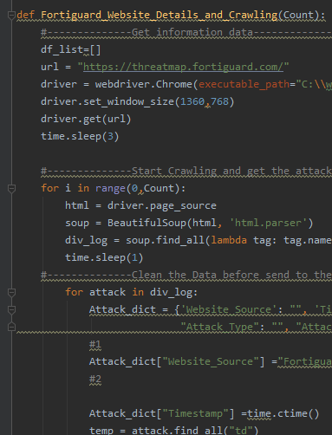
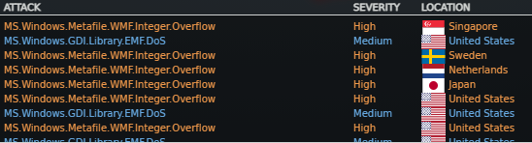
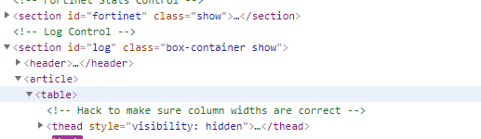
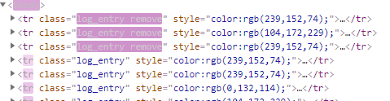
Obtaining Data
Fortiguard Web Crawling
By selenium I grab the attacks at real time , with BeautifulSoup I using Parsing and export
the relevant data :
Timestamp
Attack Source
Attack Target
Attack Type
Attack Name

Slide 8

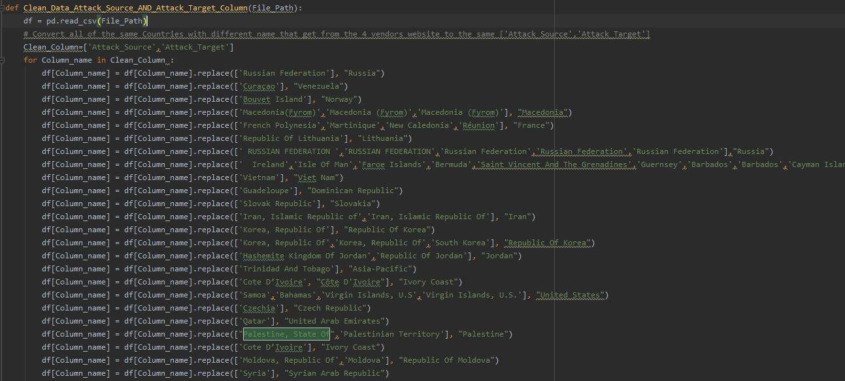
Scrubbing Data
Data cleaning
Syntax mismatch: I collect data from different website, Each website has a different form of writing , need to adjust the different country names to one identity name
Same Data different name : Convert all the same Attack Type that get from the 4 vendors website to the same Attack Type. Investigate the attribute for each attack type in each website and comparing

Slide 9

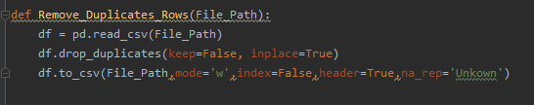
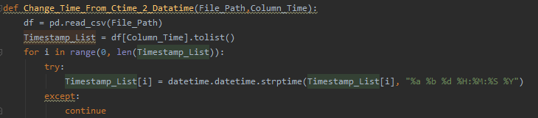
Scrubbing Data
Data cleaning
Remove Duplicates : While grabbing the data , I save the same attack more than one time, need to remove duplicate before EDA
Different Timestamps : Change timestamps data from Ctime to Datatime
Writing form: Handle spaces, uppercase letters and lowercase letters

Slide 10
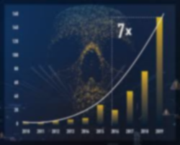
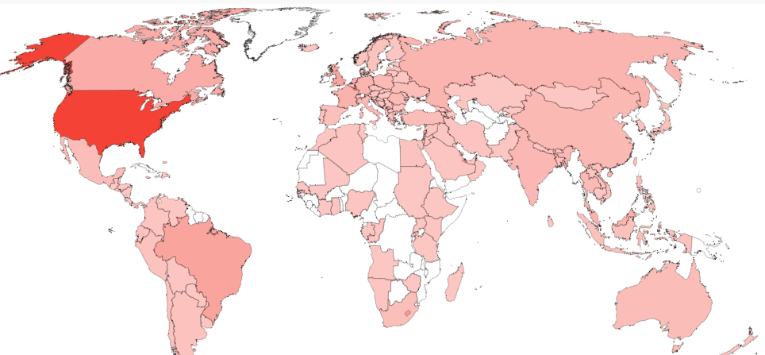
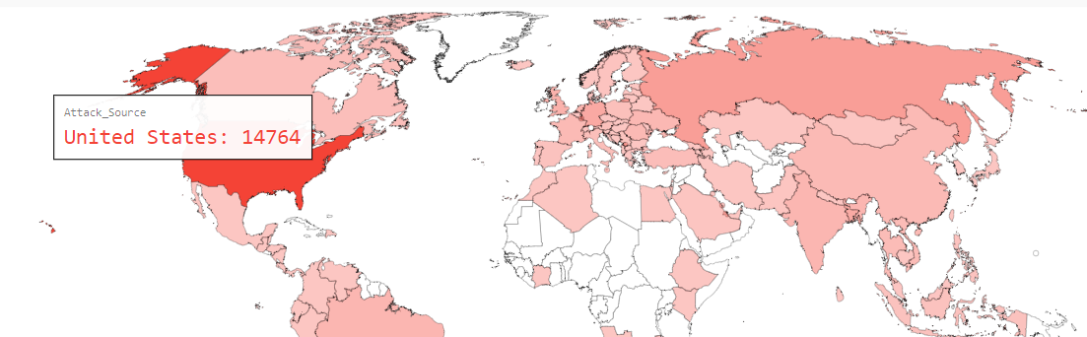
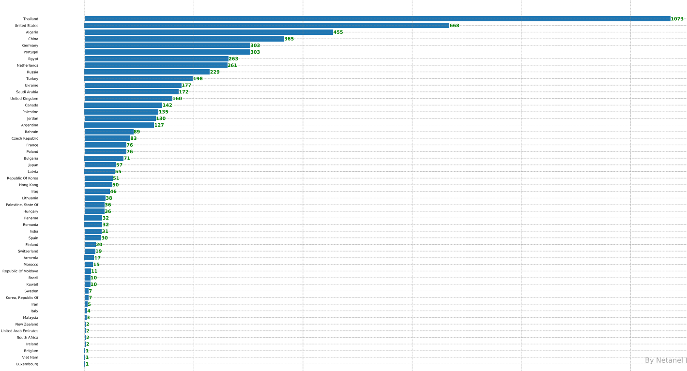
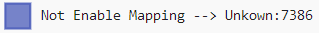
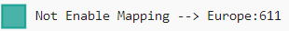
EDA & Visualizations
Present the attack cyber over the world with world map and Graphs.
View cyber attacks between a date range.
View cyber attacks according to types of attacks.
Traffic that not unable to present on the world map

Slide 11
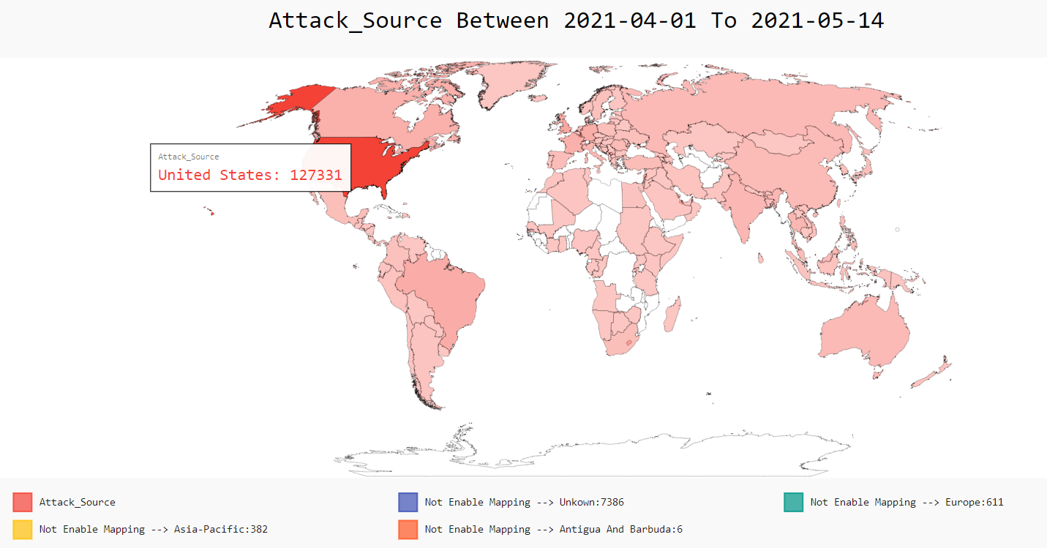
EDA & Visualizations
View All attack source by world map

Slide 12
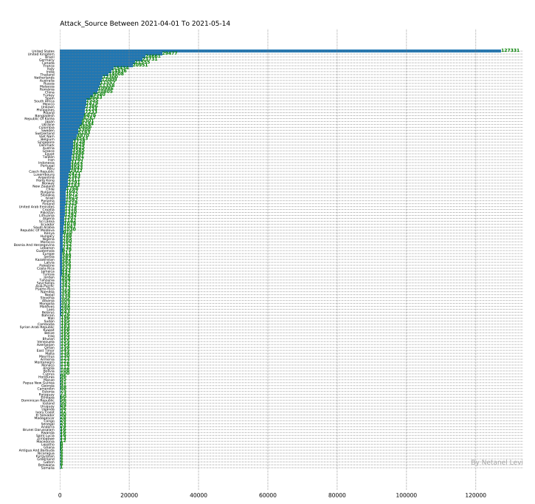
EDA & Visualizations
View All attack source by Graph

Slide 13
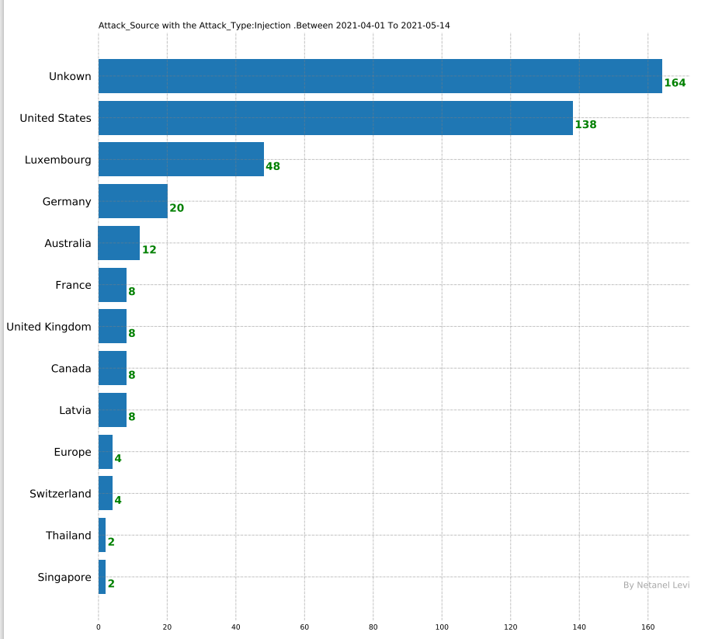
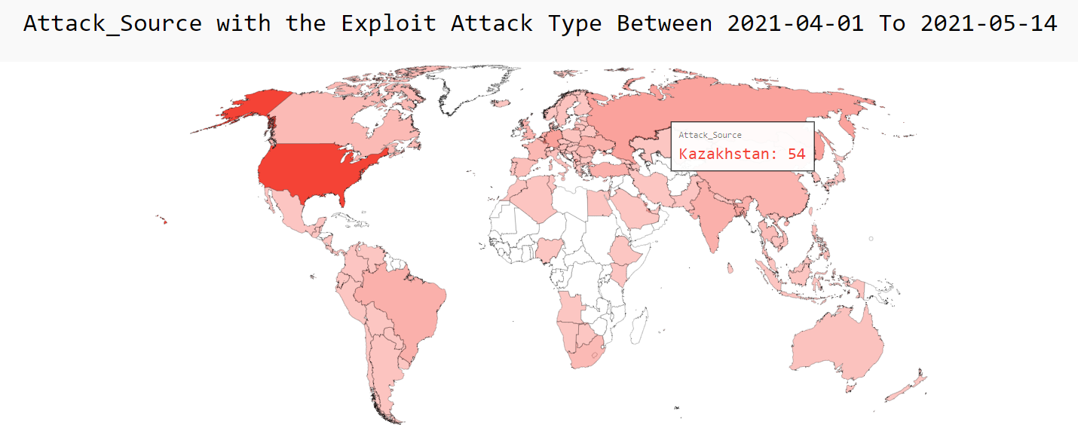
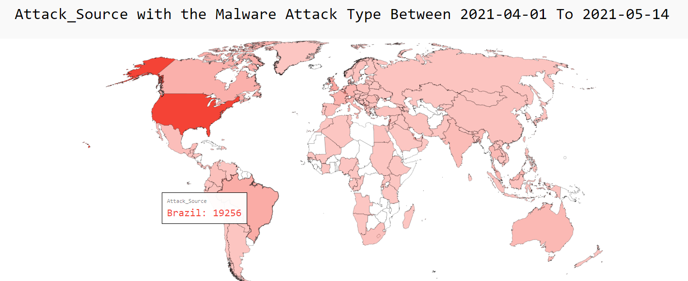
EDA & Visualizations
View All attack source with specific attack type

Slide 14
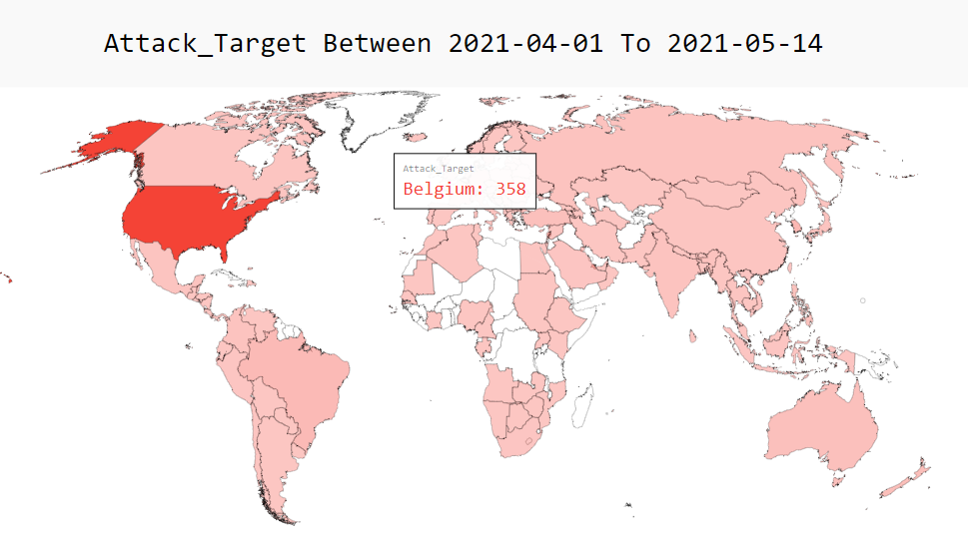
EDA & Visualizations
View All attack target by world map

Slide 15
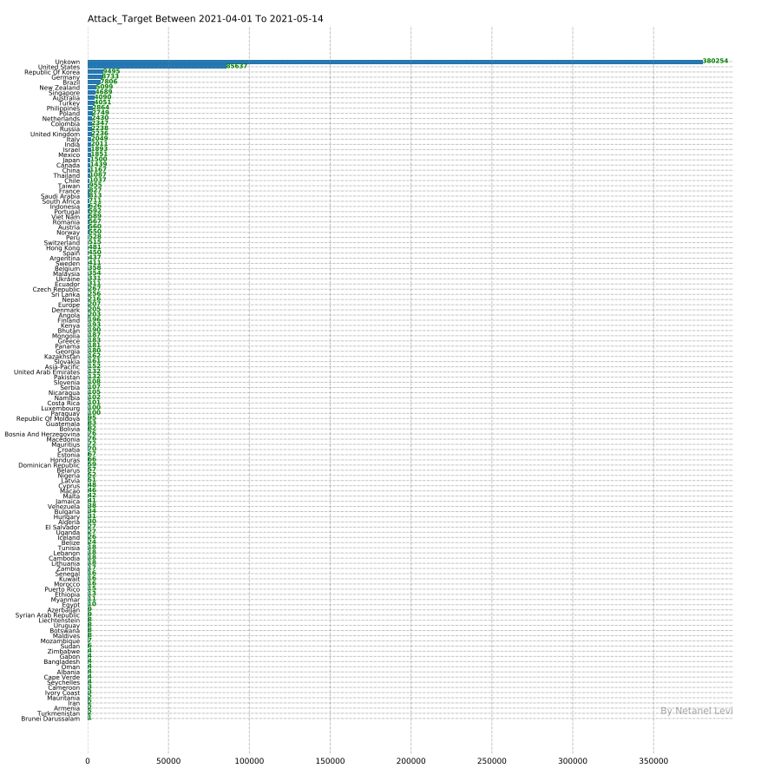
EDA & Visualizations
View All attack target by Graph

Slide 16
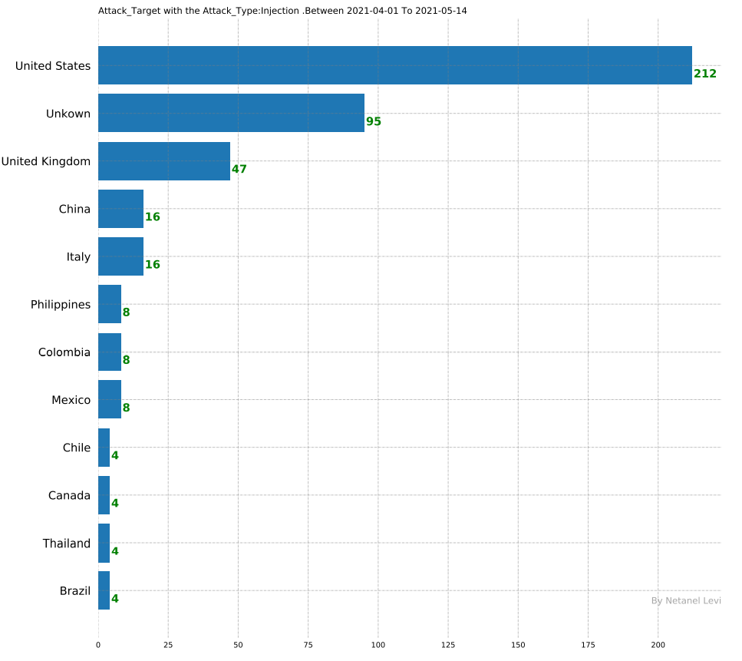
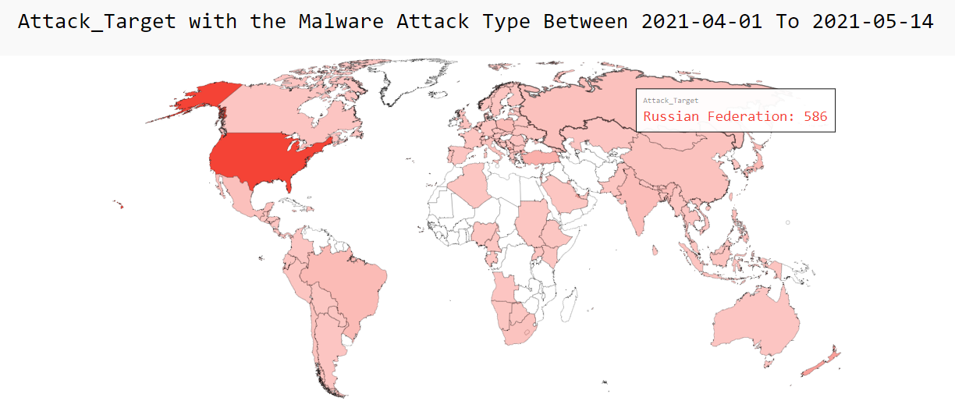
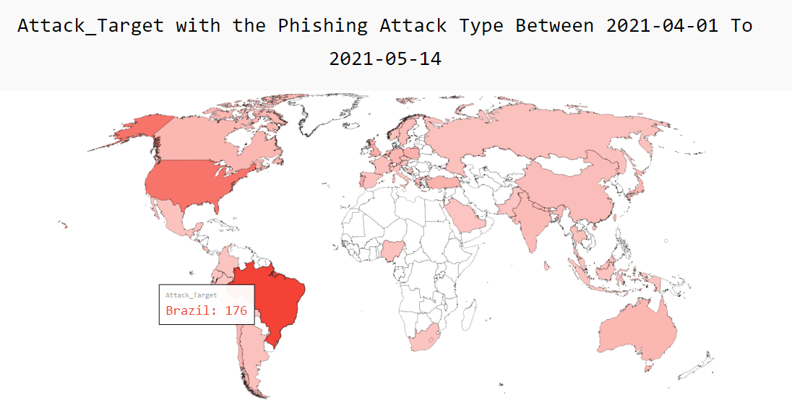
EDA & Visualizations
View All attack target with specific attack type

Slide 17


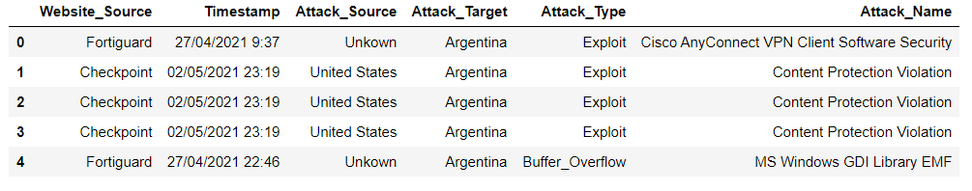
Machine Learning
Introduction
In this project, we will do data analysis on attacks by analyzing the relationship between 3 attack features: Attack source, Attack target, and Attack Type. A machine learning model will be used to predict one or two of those features given other features. And by analyzing the accuracy score we can conclude how strong is the relation between the model inputs and the output features.
Data préparation
The data use has 6 columens:
In this project, we will focus on 3 features: Attack source, target, and type.
After that, we perform a label encoding process on those 3 features to have numerical data.
Machine Learning Model: Random-Forest-Classifier
In brief random Forest build many decision trees, each tree give its decision(prediction) and at the end the random forest make a vote to select the predicted class with most votes as the final prediction

Slide 18
Machine Learning
5 Project Goals:
1.predict the next attack target, based on the 'Attack_Source' column (display/print the 5 most Chance to the next attack target for each unique country on the 'Attack_Source' column)
2.predict the next attack target, based on the 'Attack_Source' and 'Attack_Type' column (display/print the 5 most Chance to the next attack target)
3.predict the next Source attack, based on the 'Attack_Target' column (display/print the 5 most Chance to the next attack target)
4.predict the next Source attack, based on the 'Attack_Target' and 'Attack_Type' column (display/print the 5 most Chance to the next attack target)
5.predict the next Source & Target attack for each uniquely values from the 'Attack_Type' column.

Slide 19

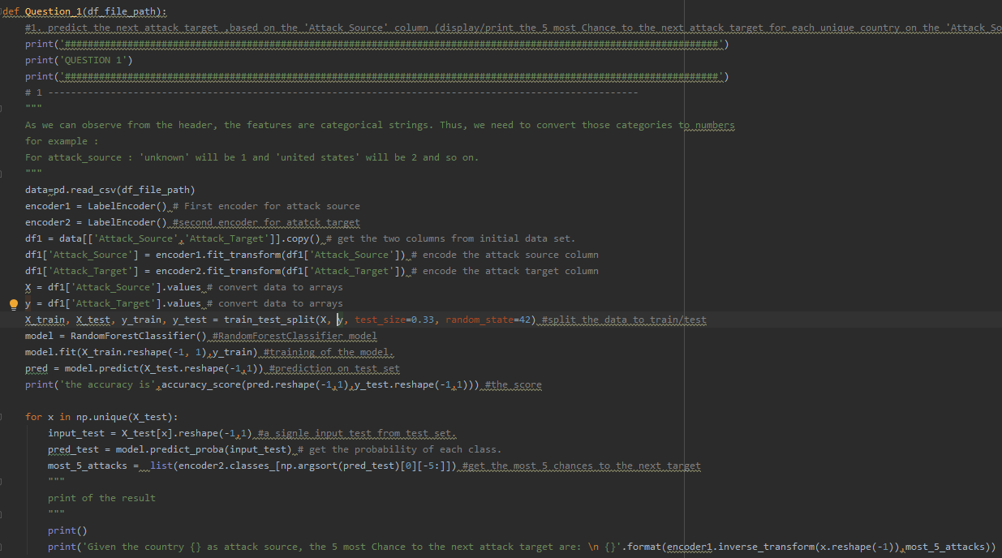
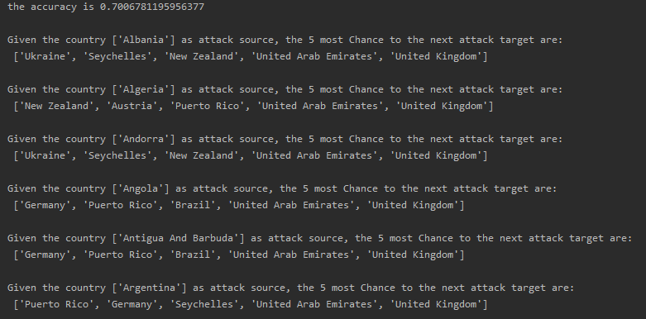
Machine Learning
1.predict the next attack target, based on the 'Attack_Source' column
The relation between Attack_Source and Attack_Target
In this case, the model takes the Attack Source as input and predicts the Attack Target. The testing model on the test set shows an accuracy of 70%. Thus, knowing the attack source we have about a 70% chance to know its exact target.

Slide 20
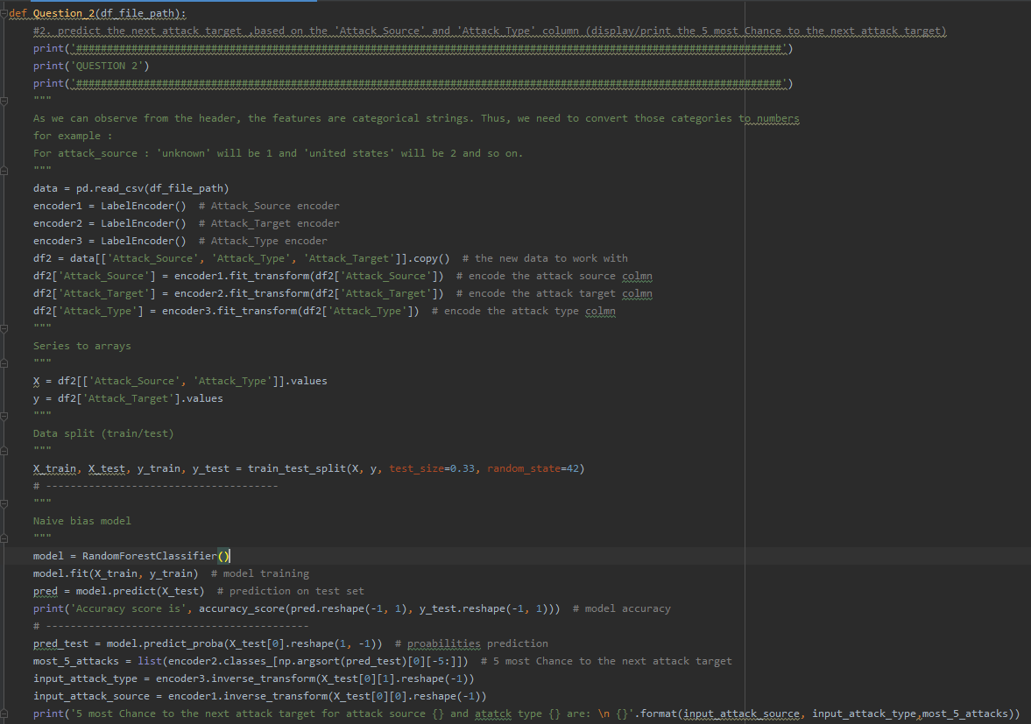
Machine Learning
2.predict the next attack target, based on the 'Attack_Source' and 'Attack_Type' column
The relation between attack target and Attack_Source, Attack type
In addition to the attack source, we add attack type to predict the attack target. Against our expectation, the accuracy goes to 80%. which means that the attack type has a high contribution to predicting the attack target.
Example, for the United Kingdom:

Slide 21
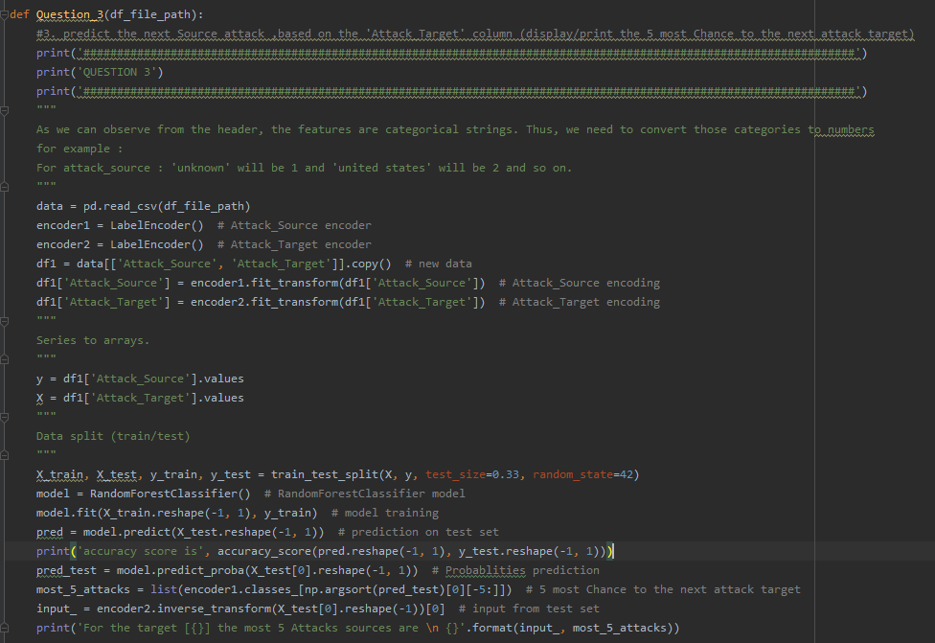
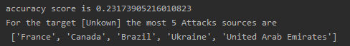
Machine Learning
3.predict the next Source attack, based on the 'Attack_Target' column
The relation between attack target and Attack source
Now the opposite we take the target as input to predict the source. The model accuracy achieved less than 23%. Thus, knowing the target doesn't mean necessary to know the target but the opposite is more possible like we observe in 1)
Example, for the Unkwon:

Slide 22
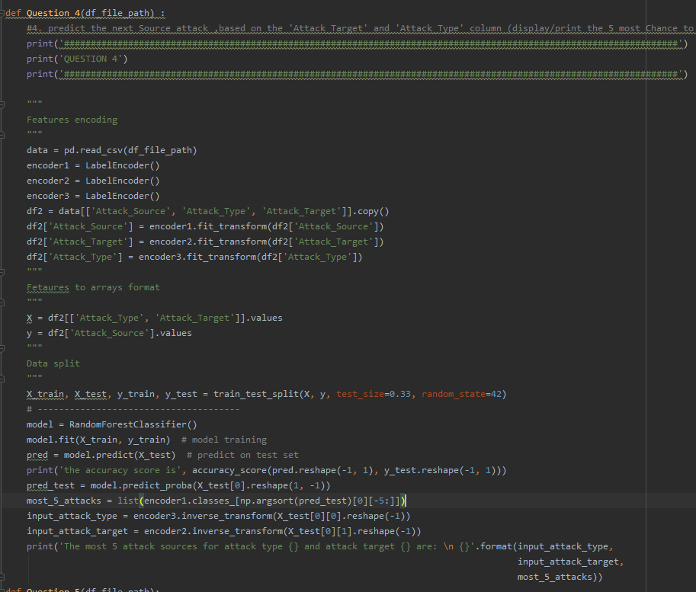
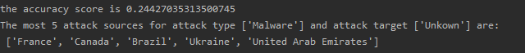
Machine Learning
4.predict the next Source attack, based on the 'Attack_Target' and 'Attack_Type' column
The relation between Attack Target and Attack_Source, Attack type
In 3 , we saw that the attack target can’t predict the attack source, now by adding the type the accuracy is still very low 24%.
Example, for the Unkwon and attack type Malware:

Slide 23
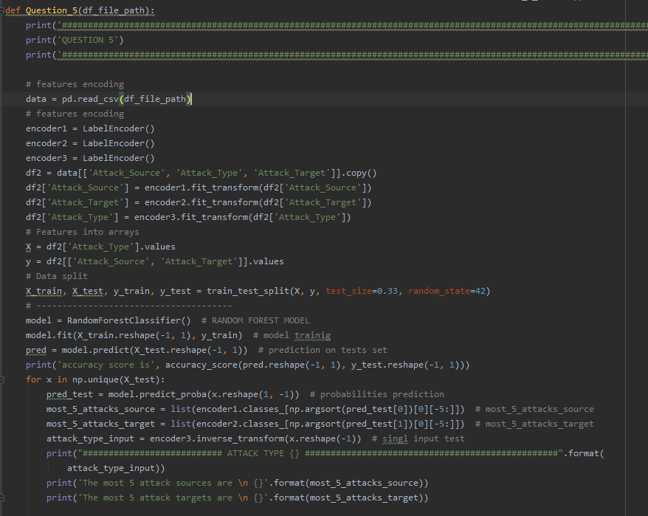
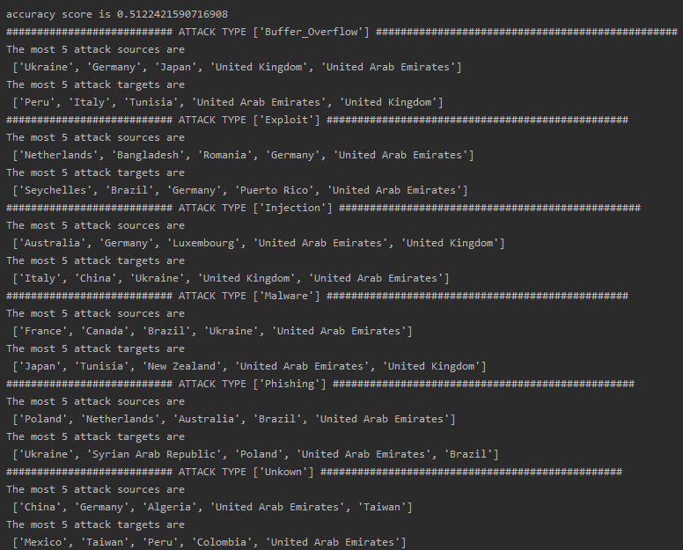
Machine Learning
5.predict the next Source & Target attack for each uniquely values from the 'Attack_Type' column
The relation between Attack type and (Attack Target/ Attack_Source)
Using the attack type, we try to predict the both attack source and target. From the accuracy which is 51%, we can see that there is a pattern between the attack type and attack target/source.
For each unique attack type:

Slide 24

How to improve the project ?
Collect more data, with a wider date range.
Save data with real DB, like SQL.
Upgrade/Change the machine learning model, maybe there is a better model.
Handle with unknown values.
Add more code map for the world map view

